Slide 1
Frontal Fibrosing Alopecia
Dr.Armaghan Gh.Zare
Dermatologist
Assistant Professor at Tabriz University of Medical Sciences
Feb 2021

Slide 2
Key Points
Frontal fibrosing alopecia (FFA) is a primary scarring alopecia characterized by a lichenoid lymphohistiocytic infiltrate around the infundibula-isthmic region of the hair follicle.
There are no pathological criteria, at present, to distinguish FFA from lichen planopilaris. FFA is not limited to the scalp, but frequently affects the face and the limbs.
Due to the lack of randomized clinical trials and the lack of a control group in clinical studies, treatment of FFA is not evidence based.
The aim of treatment is to stop disease progression. This might be achieved with topical, intralesional, and oral treatments, often combined together.

Slide 3
Pathogenesis
Frontal fibrosing alopecia (FFA) was first described by Kossard in 1994
presenting with a band of frontotemporal hairline recession associated with perifollicular erythema and a marked decrease, or complete loss, of the eyebrows
difficult to recognize in its debut because it is subtle and usually slowly progressive
Early recognition of the disorder would allow early treatment and eventually prevent disease progression.

Slide 4
Pathogenesis
Much more common in postmenopausal females.
More frequently in Caucasian patients.
probably previously misdiagnosed as traction alopecia, androgenetic alopecia, or alopecia areata.
The infundibulo-isthmic (bulge) region of the hair follicle is attacked by an immune-mediated inflammatory infiltrate, characterized by a prevalence of CD8+ T lymphocytes.
Loss of the follicular immune privilege, and a peroxisome proliferator activated receptor (PPAR)-γ deficiency might enable the inflammatory process to attack the stem cells in the bulge region and permanently destroy them.

Slide 5
Pathigenesis
PPAR-γ has a strong antifibrotic activity and its decline could correlate with the fibrogenic inflammatory process of FFA
Tziotzios et al. proposed a possible autosomal dominant inheritance with incomplete penetrance
It is also possible that FFA occurs in family members because they are exposed to the same triggers
DHEA and DHEA-sulphate are essential for PPAR-γ activity, and their decline with menopause could explain the PPAR-γ deficiency described in FFA

Slide 7
• In women, FFA is associated with autoimmune disorders (hypothyroidism, LPP and rosacea), facial sunscreens, occupational exposure to alkylphenolic compounds, and hormonal factors (pregnancy, HRT and raloxifene).
• In men, FFA is associated with facial sunscreens and antiageing creams.

Slide 8
FFA occurs in both in pre- and postmenopausal women, is relatively rare in males, frequently affects androgen-independent hairs such as the eyebrows, is not affected by hormone replacement therapy
Increased scalp sweating has been reported in some patients with FFA
In fact, antisweat therapy improved scalp itch and inflammation with disease stabilization.
Harries MJ et al. hypothesized that the inflammatory process occurring in FFA may induce a sweating refex or may modulate the sweat secretion. It is also possible that the increased sweating in the forehead and frontal hairline triggers and maintains the hair follicle inflammation.

Slide 9
Environmental factors such as leave-on cosmetics are under evaluation as potential triggers for FFA. Aldoori et al. reported a doubled incidence of use of facial sunscreens in FFA patients compared with controls
An increased prevalence of sensitization to fragrances could reflect greater use of cosmetics in the FFA population
No association between FFA and other facial products, haircare products, and hairstyle procedures (especially perms or tractions) has been proven

Slide 10
Cranwell WC, Sinclair R. Sunscreen and facial skin care products in frontal fibrosing alopecia: a case control study. Br J Dermatol. 2018. https://doi.org/10.1111/bjd.17354.
UV filters could be a major culprit, since these were added to products in the late 1980s.
a recent case–control study confirmed an increased use of sunscreen-containing facial products in FFA patients
Detected titanium dioxide nanoparticles in the hair shaft of a patient with FFA. This result was confirmed by a recent study that detected titanium dioxide in the hair shafts of 16 patients with FFA and three control females
Patch tests with titanium are negative in FFA patients
titanium could penetrate the follicular ostia causing a lichenoid reaction, but it may also enter the cells due to the very small size of its particles. Definitive proof of its role in FFA requires a carefully designed and large prospective study (Thompson CT et al.)
Fonda-Pascual et al. reported that tobacco exposure could reduce the severity of FFA, although they could not demonstrate that smoking is a protective factor

Slide 11
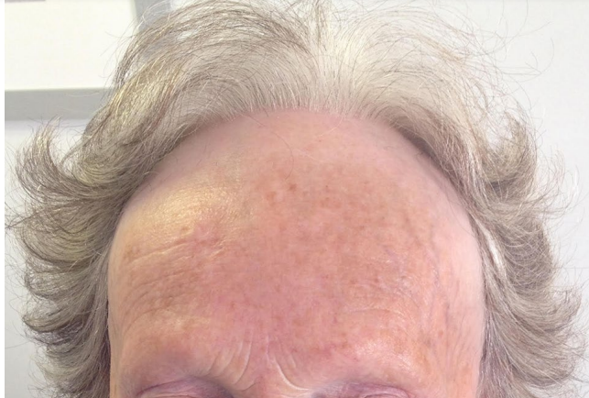
Clinical Features
FFA presents mainly as a band-like recession of the
frontotemporal hairline. The alopecic skin is slightly
atrophic, devoid of follicular ostia, smooth, and
lighter than the chronically sun-exposed forehead skin

Slide 12
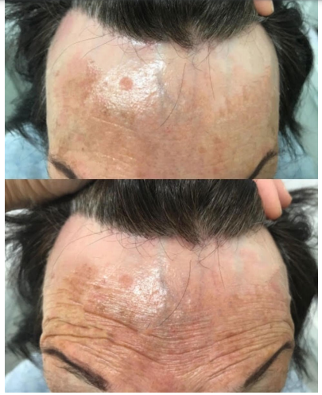
In doubtful cases, when minimal photodamage is present,
cocking of the eyebrows can help to localize the original hairline

Slide 13
3 clinical patterns
Linear:s the band of uniform frontal hairline recession in the absence of loss of hair density behind the hairline
Diffuse zig-zag: the same as linear but with at least 50% decreased hair density.
Pseudo-fringe: A clinical presentation similar to traction alopecia ,the fringe sign is the presence of some hair retained along the hairline (especially in the temporal area) ahead of the alopecic skin

Slide 15
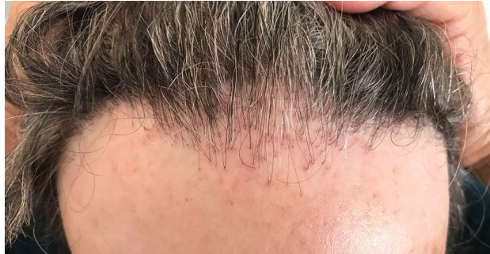
In the immediate hair-bearing skin,
perifollicular erythema and/or follicular
hyperkeratosis may be present ;
although rare, these might result in itch.

Slide 16
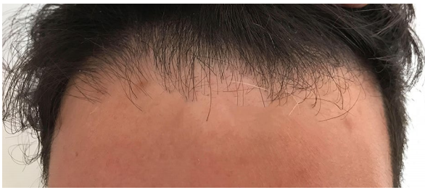
Absence of vellus hair + lonely hair sign
have been reported as typical of FFA

Slide 17
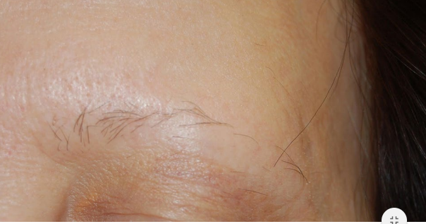
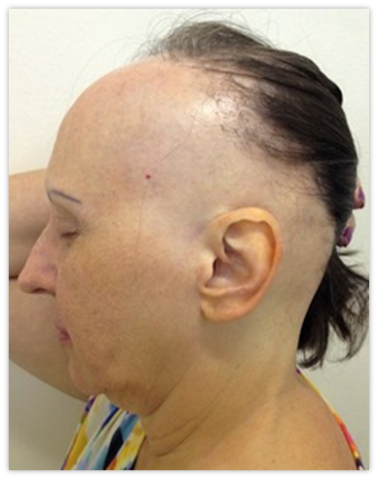
cases of isolated occipital or retro-auricular or sideburns FFA have been reported
Lateral or complete eyebrow loss, occasionally with perifollicular and interfollicular erythema, is another very common feature

Slide 19
Eyebrow loss may precede or follow the hairline involvement, but it could also be the sole presentation of the disease, leading to a misdiagnosis of alopecia areata or senile eyebrow loss .
Volume loss has been reported for the eyelashes.
Thinning of axillary, pubic, limb, and truncal hair, sometimes associated with follicular keratosis and/or erythema, can also occur before or after the scalp hair loss
Lichen planus pigmentosus is quite common in patients with dark phototype, where it is often misdiagnosed as melasma

Slide 20
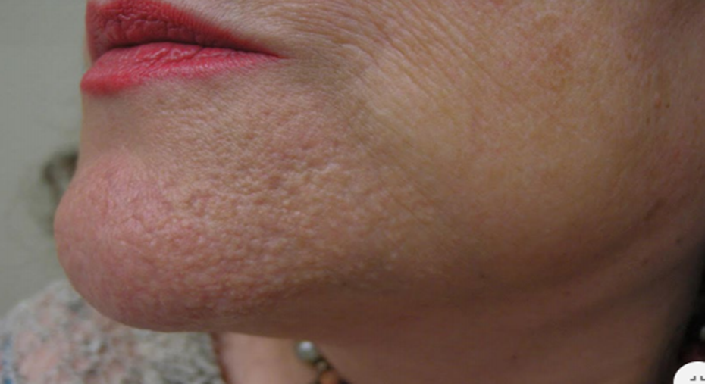
Facial papules (forehead, cheeks, chin),facial ,hypo-/hyperpigmented macules ,prominence,and depression of the facial veins have also been described in FFA-affected patients.
FFA is not limited to the scalp but also affects the skin
pathology of established papules shows absence of the hair follicle with preserved sebaceous gland and no or minimal inflammatory infiltrate
Reduction and fragmentation of elastic fibers are possibly responsible for the architecture of the papule remodeling the sebaceous gland, enlarging it, and leading to its popping out. In support of this hypothesis, facial papules improve with oral isotretinoin

Slide 21
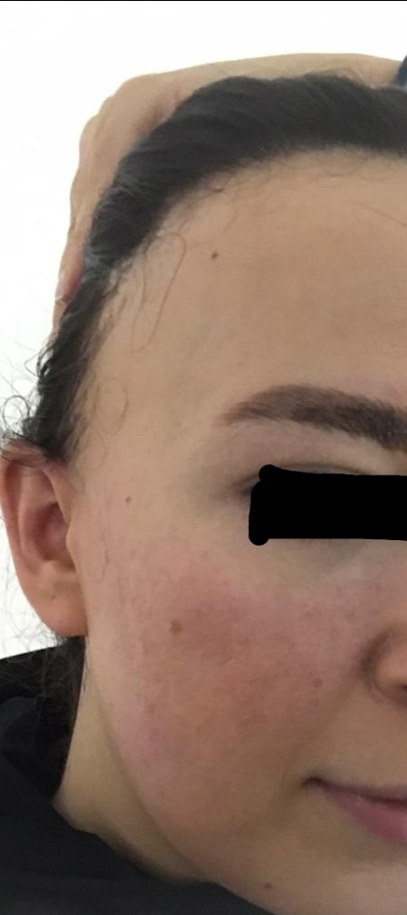
Facial erythema, sometimes associated with follicular keratosis, may be diffuse or
localized in the forehead and present as red dots .
When diffuse, erythema may cause a burning sensation and it is sometimes
misdiagnosed as rosacea
Recently, extra facial red dots/erythema have also been described as localized
in the hip and upper chest of female patients with FFA
Erythema could be an early manifestation of lichen planus pigmentosus.
Pigmented macules are frequently localized along the scalp hairline and are a sign
of pigmentary incontinence

Slide 22
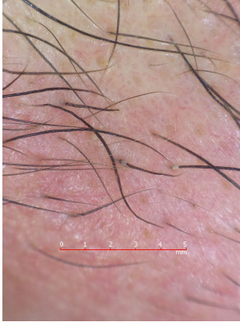
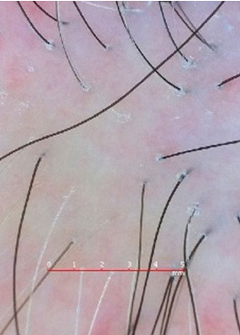
Reduced/absent follicular openings, follicular hyperkeratosis (peripilar casts) and perifollicular erythema are seen around terminal hairs
These are signs of active inflammation, but not necessarily signs of disease progression
Absence of vellus hair is diagnostic and allows fast differentiation of FFA from androgenetic alopecia.
Pili torti and broken hairs are commonly seen as well as black dots

Slide 23
Histopathology
In early stages a lichenoid lymphohistiocytic infiltrate around the outer root sheaths in the infundibular and isthmus regions and a mild perifollicular lamellar fibrosis are present.
Late stages are instead characterized by more severe perifollicular fibrosis, with reduced follicular density until scar tissue replaces the pilosebaceous units
Tosti et al. noticed that sparing of the interfollicular epidermis from the inflammatory infiltrate (perivascular/periadnexial infiltrate is absent) and eosinophilic necrosis of cells of the ORS are distinctive characteristics of scalp FFA
The different depth of inflammation might explain the different and milder clinical scarring picture of FFA than that of LPP.

Slide 24
The ‘follicular triad’ has been reported as a histopathological clue to the diagnosis of early FFA :
inflammatory infiltrate simultaneously involving :
vellus, intermediate, and terminal hair, at the same time and at different stages of cycling

Slide 25
Diagnosis
Two major criteria or one major criterion and two minor criteria are required to diagnose FFA:
Major criteria include cicatricial alopecia of the frontal/temporal/frontotemporal scalp (in the absence of follicular keratotic papules on the body) and diffuse bilateral eyebrow alopecia.
Minor criteria include trichoscopic features, histopathologic features of cicatricial alopecia in the pattern of FFA and LPP, involvement of additional FFA sites (occipital area, facial hair, sideburns, body hair), and presence of non-inflammatory facial papules

Slide 27
the Frontal Fibrosing Alopecia Severity Score (FFASS)
The FFASS evaluates hairline recession, eyebrows, perifollicular inflammation (severity and extent), and associated symptoms such as pruritus and pain

Slide 28
Management Topical agents
Topical Corticosteroids :
Not recommended as monotherapy
A systematic review on therapeutic options for FFA found that high or moderate potency tCS led to no response in 93% of cases.
In a cohort study of 72 patients by Heppt and colleagues, the authors found that combining high-potency tCS (topical clobetasol or betamethasone valerate) with a topical calcineurin inhibitor (tCI) (pimecrolimus 1% cream) initially improved hair loss in 64.6% of patients
Results from larger reviews suggest that tCS are clinically beneficial in some FFA patients with active disease when combined with other treatments.

Slide 29
Topical Calcineurin Inhibitors
Fertig and Tosti detail that tCI are part of their favored course of combination treatment, noting that they treat a large number of FFA patients and have had the best results using combination medical therapy with tCI, oral finasteride, hydroxychloroquine, and excimer laser
patients who were treated with tacrolimus 0.3% were more likely to achieve stabilization of hair loss within 3 months in comparison with tCs
tCI, when used as an adjuvant treatment, resulted in positive effects in over 50% of treated patients
Reported side effects from tCI use include erythema and scaling
tCI have a place in FFA treatment and may be efficacious when combined with other treatments, perhaps even more so than tCS.

Slide 30
Topical Minoxidil
Inhibiting excess fibroblasts and increasing vascular endothelial growth factors
as monotherapy is not recommended for patients with FFA
Tosti and colleagues reported positive results when treating FFA patients with topical minoxidil 2% BID in conjunction with oral finasteride 2.5 mg per day, successfully halting disease progression in 50% of patients after 12–18 months of treatment.
It should particularly be considered in patients with mixed FFA and androgenetic alopecia, which is not an uncommon presentation
Combination with tCI and tCS

Slide 31
Intralesional Corticosteroids
often considered part of the mainstay of treatment for FFA
positive clinical response rate of 83% in patients with FFA who received ILCs’ injections every 3 to 6 months, with an average of eight injections in total
treatment with ILCs and 5α-reductase inhibitors should be combined in patients who exhibit follicular hyperkeratosis and perifollicular erythema on the exam.
A systematic review by Ho and Shapiro found that ILCs’ injections were one of the most beneficial therapies utilized, resulting in a positive treatment response in 88% of patients
0.5 to 3 mL per session, every 6 to 8 weeks injected into the frontal scalp, was beneficial in DS after 4 to 5 sets of injections.
20 mg/ mL of intralesional triamcinolone acetonide injections every 3 months to the frontal hairline and eyebrows achieved DS.
ILCs injections may also be beneficial in patients who have had longstanding disease when utilized as a part of a combination therapy regimen

Slide 32
Oral Anti-Inflammatory Agents
Hydroxychloroquine
Is considered a first-line systemic agent due to its anti-inflammatory properties and relatively low ASE profile
Ho and Shapiro reported, in a systematic review, that overall improvement in the Lichen Planopilaris Activity Index (LPPAI) score was seen in 74% of patients treated with hydroxychloroquine 200 to 400 mg per day alone, while stabilization was found in 71% of patients who
Samrao and colleagues described treating 15 FFA patients with hydroxychloroquine and reported that 73% experienced a reduction in signs and symptoms after 6 month
Nearly half of patients with FFA treated with oral hydroxychloroquine at Mayo Clinic achieved SDP or DS
American Academy of Ophthalmology recommends that all patients on hydroxychloroquine or chloroquine receive a baseline ophthalmologic examination as well as annual screenings after 5 years of use, with any patient who experiences vision loss advised to stop the medication and be evaluated by an ophthalmologist

Slide 33
Oral Tetracyclines
when compared to patients treated with oral hydroxychloroquine, Strazzulla and colleagues reported that patients treated with doxycycline, tetracycline, or minocycline had no significant differences in outcomes but were more likely to experience ASE including nausea, esophagitis, lightheadedness, photosensitivity, skin eruption, and candida infection
responses to oral tetracyclines have been somewhat unpredictable. While some patients do appear to experience benefit, ASE of tetracycline-class antibiotics may limit their use

Slide 34
5α-Reductase Inhibitors
Being one of the most efficacious treatment options currently available for FFA
treatment with finasteride 1 to 5 mg per day or dutasteride 0.5 mg per day stabilized hair loss in 88% (158/180) of patients.
Vañó-Galván and colleagues reported on 120 patients with FFA who were treated with 5α-reductase inhibitors.4 Of those who received finasteride 2.5 to 5 mg daily, 47% (48/102) showed symptomatic improvement and 52.9% (54/102) experienced DS. Of those who received dutasteride 0.5 mg weekly, 44.4% (8/18) exhibited improvement while 55.6% (10/18) achieved DS.
In a recent large study of 224 patients with FFA, Pindado-Ortega and colleagues reported that dutasteride was the most effective therapy with a dose-dependent response compared to other systemic therapies or no systemic treatment

Slide 35
It has been recommended that patients who seek to halt disease progression consider 5α-RI as part of their treatment regimen
recommended initiating patients with hairline recession greater than or equal to 1 cm on initial combination therapy with finasteride 5 mg per day if premenopausal or dutasteride 0.5 mg per day if postmenopausal, in addition to intralesional triamcinolone acetonide 2.5 mg/mL per month, and a topical protocol consisting of tacrolimus 0.3% in Cetaphil cleanser, clobetasol solution, and minoxidil 5% solution
5-alpha reductase inhibitors, in combination with systemic retinoids (isotretinoin), were described as the most effective therapeutic options for patients who were treated for FFA

Slide 36
Peroxisome Proliferator-Activated Receptor γ (PPAR-γ) Agonists
PPAR-γ is a transcription factor that works in the regulation of peroxisome and lipid metabolism, with evidence suggesting that it serves a vital role in the function of pilosebaceous units and decreased expression is found in scarring alopecia
PPAR-γ agonists have shown some promise in the few reported cases and additional research is certainly warranted to further evaluate their efficacy.
PPAR-γ agonists have been associated with heart failure, hypoglycemia, edema, upper respiratory tract infection, decreased bone mineral density and fractures

Slide 37
Systemic Immunosuppressant Agents
Methotrexate
It is advised that potent immunosuppressant agents such as methotrexate are reserved for patients with refractory disease
In a Mayo Clinic study, only two patients were reported to have received methotrexate treatment, but both achieved DS as defined by no further progression of clinical features of the disease
MTX is associated with a variety of ASE including hepatotoxicity, nephrotoxicity, gastrointestinal disorders, pneumonitis, hematologic disorders, dermatitis and infections, as well as being category X during pregnancy.

Slide 38
Mycophenolate Mofetil
few studies reporting on the use of MMF
Ho and Shapiro found that MMF use resulted in improvement in 60% (3/5) of patients
In a Mayo Clinic retrospective review, out of eight patients who were treated with MMF for FFA, five achieved disease stabilization, while three experienced UDP.

Slide 39
Oral Prednisone
Kossard and colleagues reported that in patients with rapidly progressive hair loss from FFA, oral prednisone 25 to 50 mg per day slowed rapid hair loss stop in half (2/4) of cases
Ho and Shapiro suggested that patients with rapidly progressive FFA can be treated with oral prednisone 40 mg per day for 1 week, with a taper by 5 mg per week for 8 weeks, followed by the initiation of maintenance therapy

Slide 40
Other Systemic Therapies Oral Retinoids
patients who are treated with systemic retinoids as monotherapy show higher rates of DS than the patients who were treated with finasteride
In a review of 26 patients with FFA, Babahoseini and colleagues reported that systemic retinoids (isotretinoin) in combination with 5-alpha reductase inhibitors were the most effective therapeutic options for FFA patients
Systemic retinoids do have an ASE profile that must be considered, including adverse reproductive, neurological, and cutaneous effects, as well as being category X during pregnancy due to known teratogenicity

Slide 41
Naltrexone
a non-selective antagonist of opioid receptors that, is thought to have immunomodulatory effects and has been suggested for use in autoimmune disorders
a possible treatment option for scarring alopecias
To date, only one case report describes the use of low-dose naltrexone, 3 mg per day, in combination with pioglitazone 15 mg per day, to successfully treat a patient with LPP

Slide 42
Oral Minoxidil
low-dose oral minoxidil (0.25–1.25 mg/d) and low-dose sublingual minoxidil in the treatment of LPP and other alopecias including androgenetic alopecia, chronic telogen effluvium, and monilethrix, with promising results shown including increased hair thickness in LPP
a potential consideration for adjunctive therapy, particularly if the FFA is unmasking androgenetic alopecia.

Slide 43
Platelet-Rich Plasma
increased attention in the dermatologic fields of hair loss, cosmetic dermatology, and wound healing
there is some growing evidence to suggest that PRP may be beneficial when utilized as part of combination therapy for androgenetic alopecia treatment
we recommend using either three treatments, each separated by month duration and then annual or every 6-month follow-up treatment, or starting ongoing monthly therapies and reevaluating efficacy every 6 months.

Slide 44
Low-Level Lasers Excimer Laser
Excimer laser, via delivery of 308 nm of ultraviolet-B light, has been utilized as a means of treatment for a number of dermatologic disorders including LPP, alopecia areata, psoriasis, and vitiligo.
modulation of T-cells and cytokines.
Zhang and colleagues noted that excimer laser therapy was one of the most efficacious at limiting hair loss, as well as intralesional and tCS, tCI, and oral hydroxychloroquine
Similarly, Fertig and Tosti also included excimer laser treatment as one of the methods
resulting in the best clinical response in their large FFA practice, in conjunction with oral hydroxychloroquine, finasteride, and tCI

Slide 45
Hair Transplantation
Unfortunately in patients with FFA, trauma from the transplantation process may aggravate hair loss in some cases
In the largest study to date, Vañó-Galván and colleagues reviewed 51 patients with FFA who underwent hair transplant utilizing the strip technique in 86% and the follicular unit extraction technique in 14%. After 1 year, the mean graft survival rate was 87%; after 5 years, the mean graft survival rate was 41%.
the result of hair transplantation in patients with FFA is temporary.
Ho and Shapiro described that hair transplantation usually results in positive effects in the period immediately after the procedure; only 33% of patients had lasting results at 2 years post-transplant

Slide 48
Thanks for Your Attention

